Slide 1

Gesto: Mapping UI Events to Gestures and Voice Commands
Chang Min Park, Taeyeon Ki, Ali J. Ben Ali, Nikhil Sunil Pawar,
Karthik Dantu, Steven Y. Ko, and Lukasz Ziarek
University at Buffalo, The State University of New York

Slide 2





What is Gesto?
Task automation system
– Maps UI actions to a gesture or voice command
or
How does Gesto enable task automation?
Record
Start
Select
(Gestures or Voice)
UI Actions
Finish
Replay
Trigger
(Gestures or Voice)
Replay the UI Actions

Slide 3
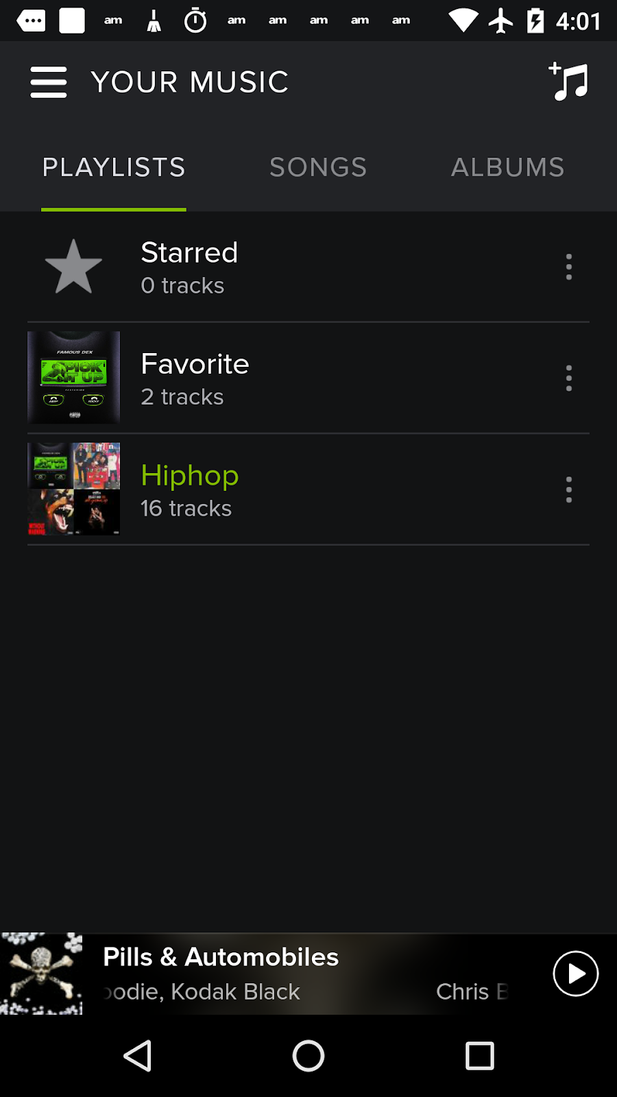
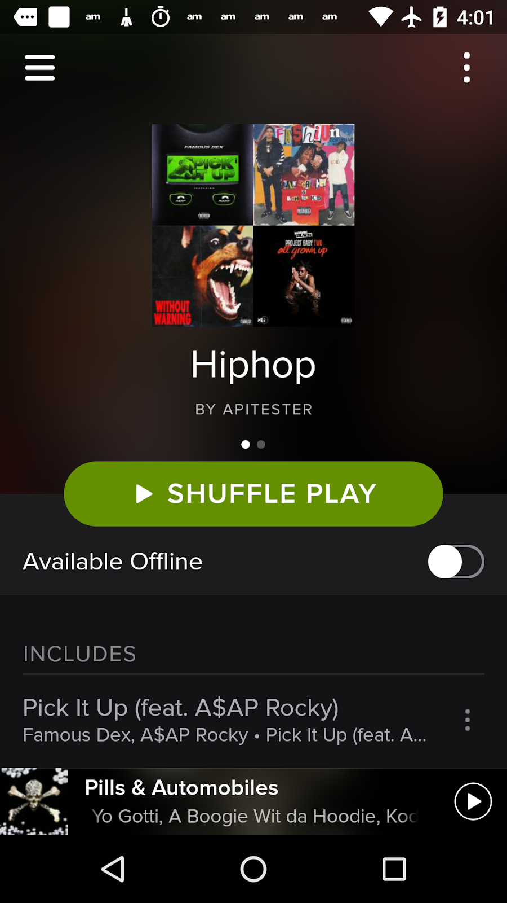
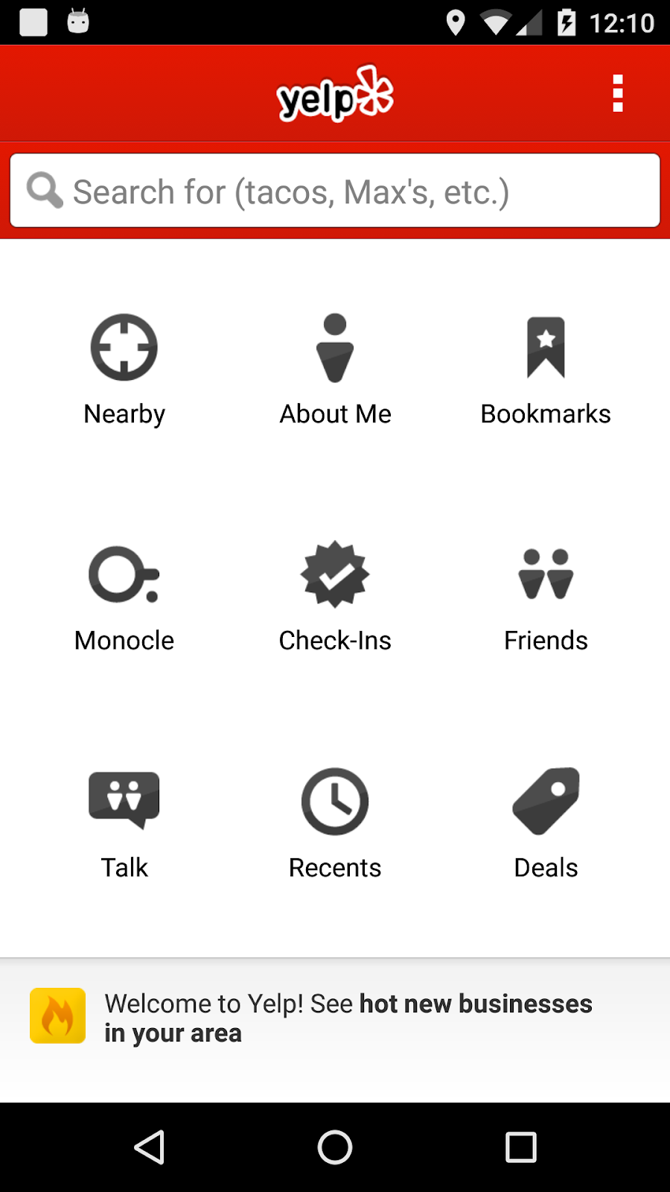
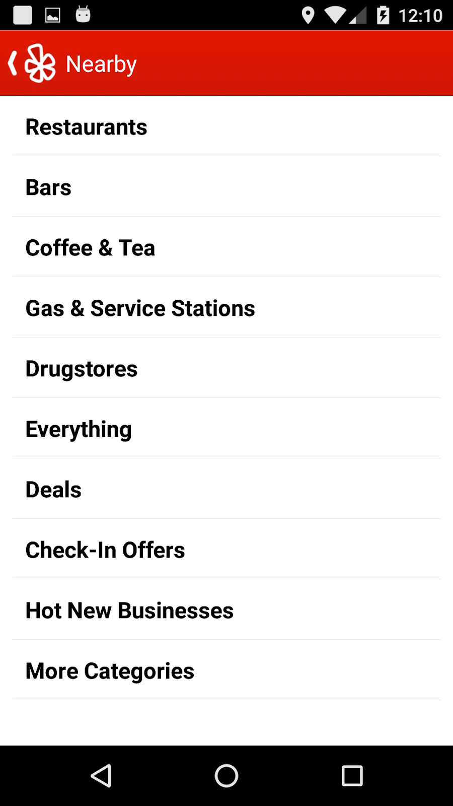
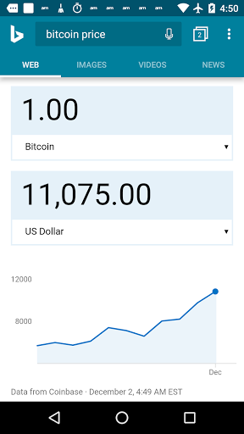
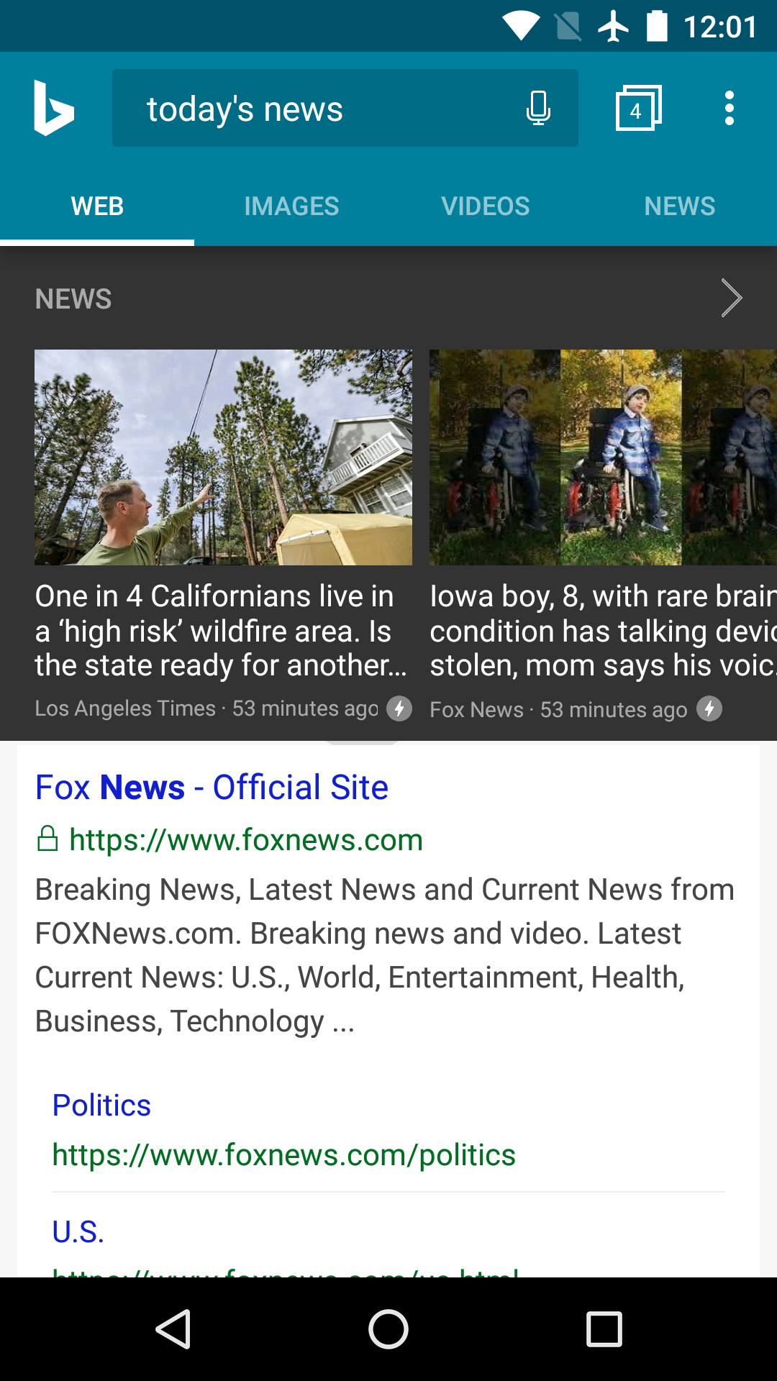
Example Scenarios
Multiple scenarios requiring task automation
1. Simplifying UI actions
2. Long sequence of UI actions
3. Frequently used UI actions
e.g., Spotify App
e.g., Yelp App
e.g., Bing App

Slide 4
Demo Video
Record and Replay – Yelp App (Instrumented with Gesto)
Due to a size limitation, the video was removed.
Please check the demo videos on the website.

Slide 5

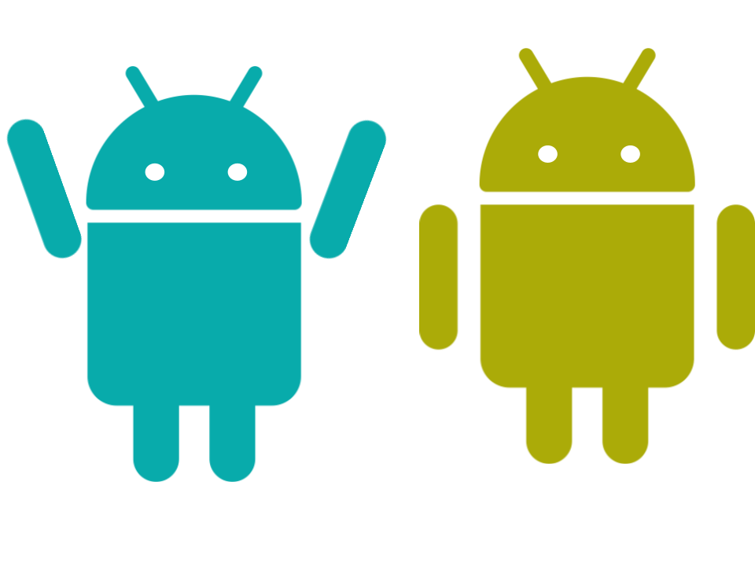
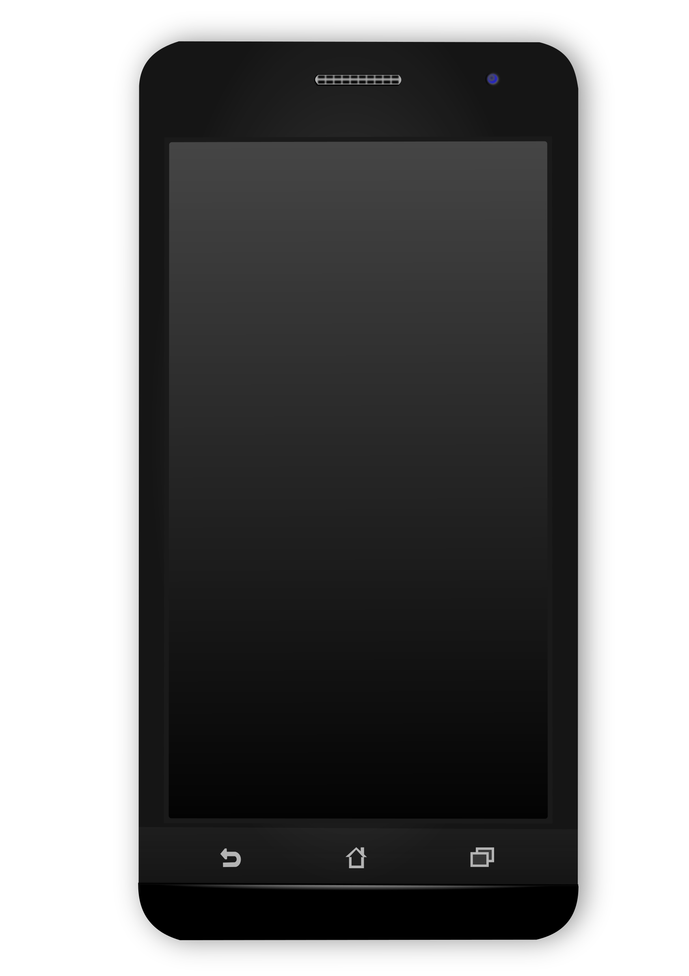

How Does Current Task Automation Work without Gesto?
To provide the functionality, each app must implement it.
Developers
Manual: app developers need to implement the functionality manually.
Users
Regular
App Code
generate
Gesto
No developer’s involvement – automatic transformation of existing apps
User-defined UI actions
Application
Task
Automation

Slide 6

How Does Gesto Work?
Instruments existing apps and injects record and replay functionality
No App-source Code
No Root Access
No Customized OS
Users
Gesto System
Modification
Injection
Existing
Application
Java Bytecode
Instrumentation
Instrumented
Application
Possible to provide as a desktop tool

Slide 7
Gesto Overview
How does Gesto record UI actions?
How does Gesto map a gesture or a voice command to the UI actions?
How does Gesto replay the UI actions?
Gesto
Recording
Mapping
Existing
Application
Instrumented
Application
Replaying

Slide 8


Gesto Overview (cont.)
1. How Does Gesto record UI actions?
Android developers implement UI callbacks to handle UI actions.
UI Callback
Item 1
Event listener interface for a UI object
Gets triggered by a user’s UI action
Button
Item 2
Item 3
onClick
onItemClick
onTextChanged
1
2
3
4
5
6
7
8
Button b = new Button;
b.setOnClickListener(new View.OnClickListener() {
public void onClick(View v) {
// Developer’s Code
}
}
Gesto injects a logging method
Logger.logOnClick(v);
- Can record the UI callback whenever a user perform the UI action
Using multiple logging methods,
Gesto records various UI callbacks.

Slide 9
Gesto Overview (cont.)
2. How does Gesto map a gesture or a voice command to the UI actions?
Currently supports 28 gestures and voice commands
- Sensey: open-source gesture recognition library
- SpeechRecognizer: provided by Android
“Shake”
Button1 → onClick
Button2 → onClick
TextBox → onTextChanged
For each gesture or voice command,
users can map a different sequence of UI actions.
Mapping Process
A user selects a gesture to map.
Gesto maps the gesture with the recorded UI actions.
Gesto stores the mapping in the app.

Slide 10
Gesto Overview (cont.)
3. How does Gesto replay the UI actions?
A user triggers a gesture.
App finds recorded UI callbacks for the gesture.
“Shake”
For each UI callback, Android provides a method that triggers the callback.
onClick
performClick
“Shake”
onItemClick
performItemClick
onFocusChange
setFocusable
onTextChanged
setText
Provided by Android platform
With these methods, Gesto triggers the recorded UI actions.

Slide 11
Evaluation
How successfully can Gesto instrument existing apps?
Downloaded 1,000 popular apps from Google Play store
How do the instrumented apps perform in runtime?
Instrumented 4 use case applications
(More questions are answered in the paper)

Slide 12
How Successfully Can Gesto Instrument Existing Apps?
Downloaded 1,000 popular apps from Google Play store
Instrumented the apps with Gesto – 949/1000 (95%)
Failed to instrument 51 apps
27 apps – failed by Tools (Soot, apktool)
24 apps – failed by Gesto
Category (Example) | # of Apps | Inst. Time Avg. | APK Size Avg. | APK Size Increase Avg.
Game (Color Switch) | 95 | 32.7s | 12.7M | 558.8K
Entertainment (Roku) | 129 | 34.1s | 10.5M | 437.4K
Media (Spotify Music) | 132 | 28.7s | 9.9M | 408.4K
Education (Brilliant) | 114 | 33.0s | 10.9M | 718.0K
Personalization (Alarmy) | 118 | 27.7s | 8.1M | 364.3K
Productivity (Evernote) | 116 | 31.5s | 7.7M | 647.3K
Business (Venmo) | 91 | 33.8s | 10.4M | 435.8K
Social (Yelp) | 154 | 31.9s | 10.4M | 675.7K
Total | 949 | 31.6s | 10.0M | 534.3K
Cannot handle the multiple DEX files
Multiple DEX files because of the size
DEX file - Dalvik executable file.
Android programs are compiled into DEX files.
7.2%
Successfully instruments existing applications with modest size increases

Slide 13
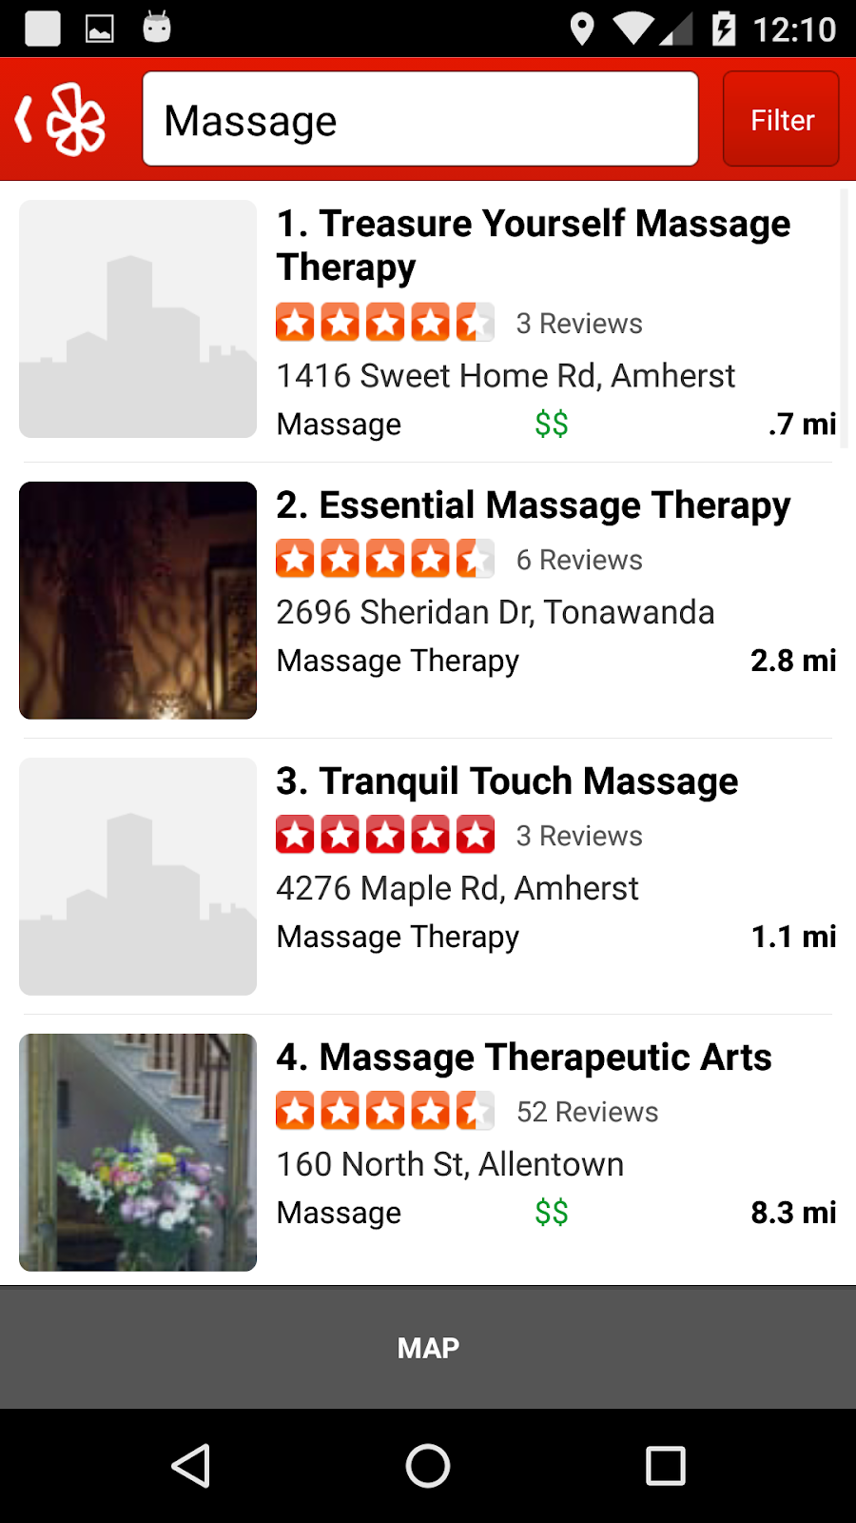
How Do the Instrumented Apps Perform in Runtime?
Instrumented 4 use case applications – Spotify, Yelp, Bing, and AVG Cleaner
Performed a defined sequence of UI actions for each app
Spotify
Yelp
“Shake” gesture
“Face-down” gesture

Slide 14
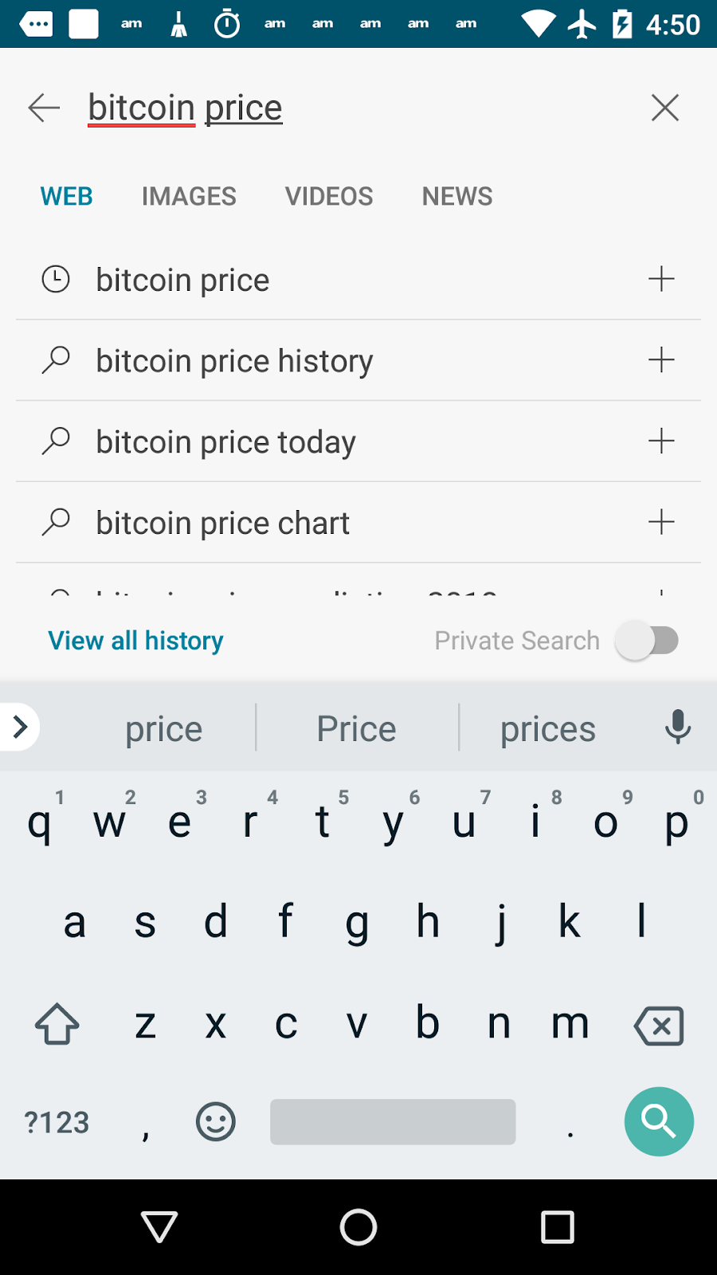
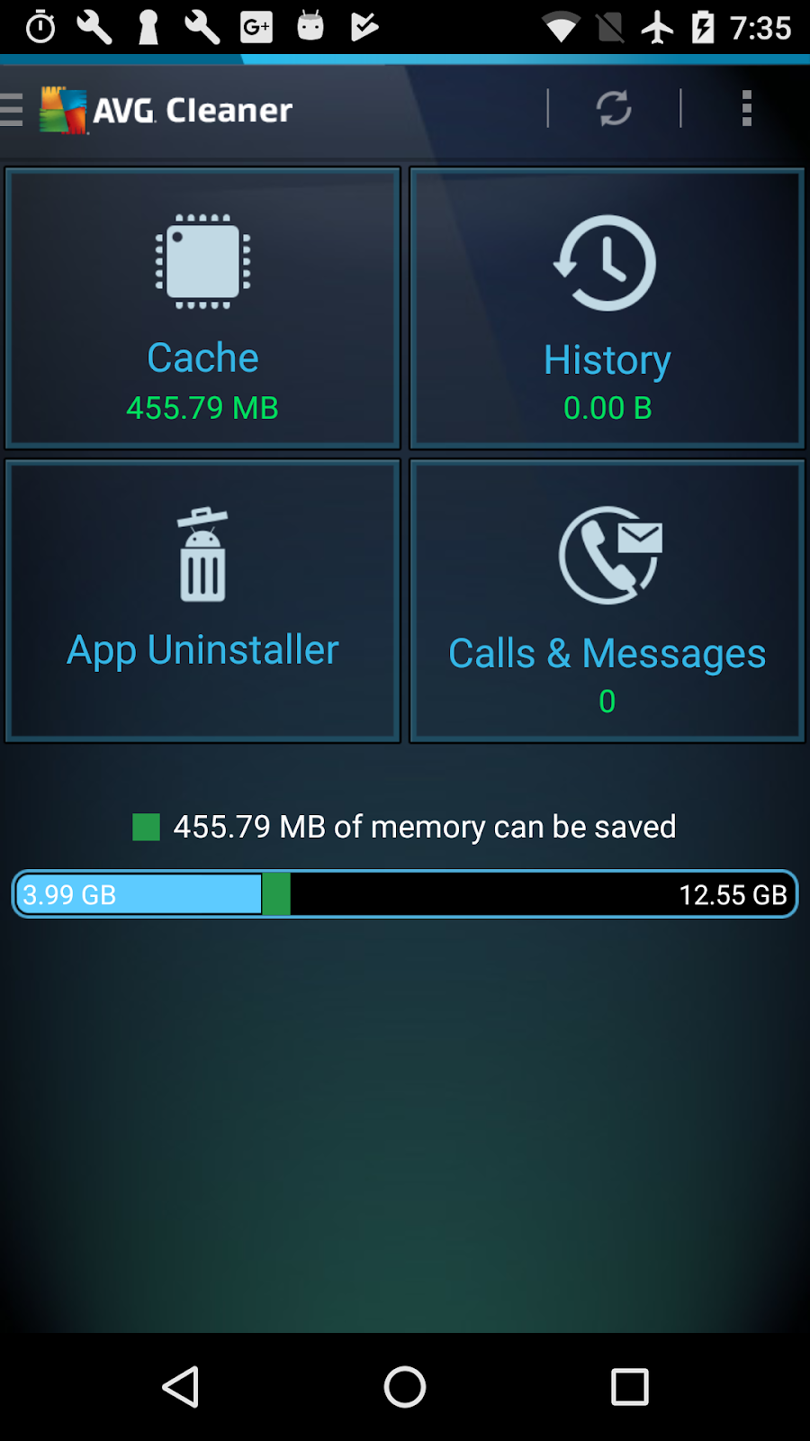
How Do the Instrumented Apps Perform in Runtime? (cont.)
Instrumented 4 use case applications – Spotify, Yelp, Bing, and AVG Cleaner
Performed a defined sequence of UI actions for each app
3 types of run – original, instrumented (record), and instrumented (replay)
Bing
AVG Cleaner
“Bitcoin” voice command
“Shake” gesture

Slide 15
How Do the Instrumented Apps Perform in Runtime? (cont.)
Evaluated – latency, heap usage, and energy consumption
Latency
Less than 1 sec overhead
LG Nexus5
Android 6.0.1
Requires extra gestures

Slide 16
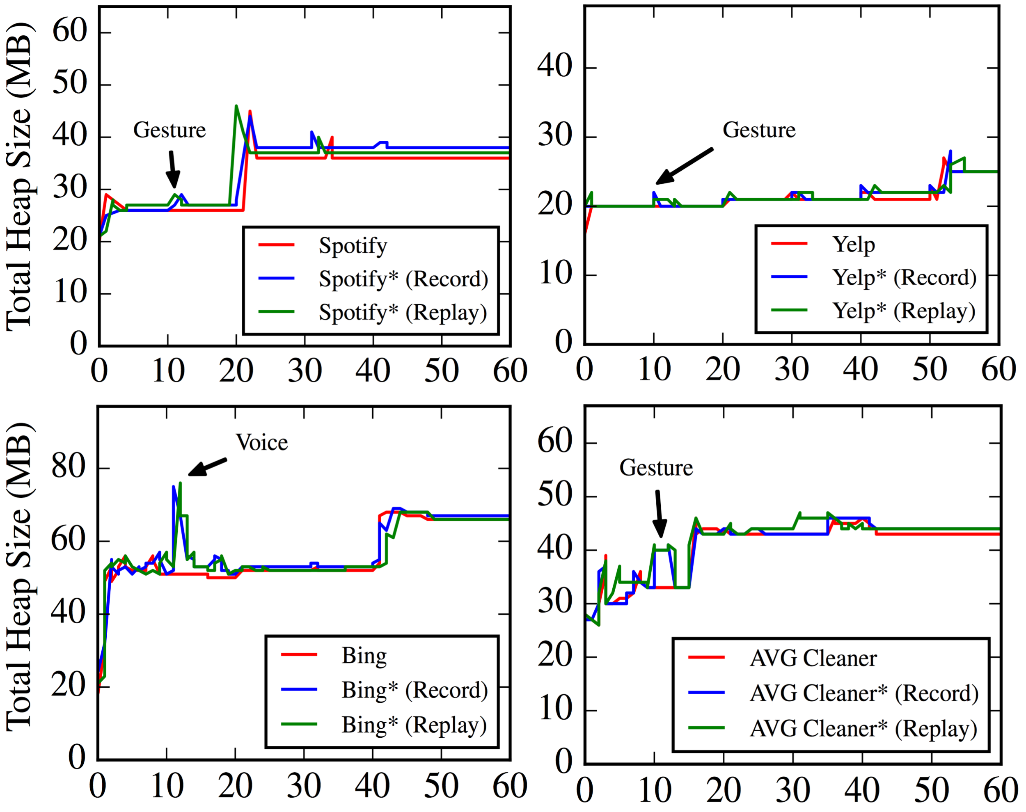
How Do the Instrumented Apps Perform in Runtime? (cont.)
Evaluated – latency, heap usage, and energy consumption
Heap Usage
LG Nexus5
Android 6.0.1
Incurs 5-15% overhead
when a gesture gets performed
Time (sec)

Slide 17
How Do the Instrumented Apps Perform in Runtime? (cont.)
Evaluated – latency, heap usage, and energy consumption
Energy Consumption
App Name | Average (J) | Std Dev (J)
Spotify | 68.9 | 5.2
Inst. Spotify (Record) | 75.0 | 5.5
Inst. Spotify (Replay) | 78.5 | 4.8
Yelp | 55.5 | 5.1
Inst. Yelp (Record) | 67.8 | 4.9
Inst. Yelp (Replay) | 64.9 | 5.1
Bing | 75.9 | 4.3
Inst. Bing (Record) | 86.1 | 6.3
Inst. Bing (Replay) | 86.9 | 6.3
AVG Cleaner | 56.5 | 4.7
Inst. AVG Cleaner (Record) | 66.0 | 3.9
Inst. AVG Cleaner (Replay) | 63.2 | 2.4
Samsung Galaxy S4
Android 7.1.2
Monsoon power monitor
incurs 16.9% overhead when
a recording or a replaying is performed
Mainly from extra sensors Gesto uses
Can be reduced by existing energy efficient gestures or voice recognition

Slide 18
How Do the Instrumented Apps Perform in Runtime? (cont.)
Latency
Incurs less than 1 sec overhead
Heap Usage
Incurs 5-15% overhead only when gestures get triggered
Energy Consumption
Incurs 16.9% overhead but can be optimized by other techniques
Show that Gesto incurs modest overhead in runtime

Slide 19

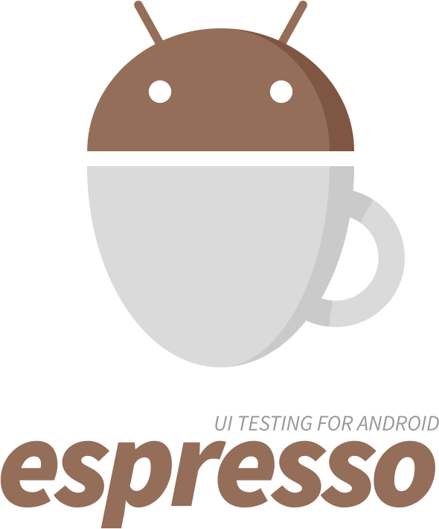




What about Other Systems?
Multiple systems – enabling record and replay feature on existing apps
Culebra
Limitations
Intrusive – require app-source, root access, or customized OS
Position (coordinate) based – don’t work on other device (different screen size)
Mainly for testing – require a desktop control
No mapping – with gestures and voice command
Frep
Screen
Button
(x,y)
Many challenges solved in the paper

Slide 20
Conclusion
Gesto
Provides task automation
Does not require
- App-source code, root access, customized OS, and desktop control
Successfully handles
Recording UI actions – logging UI callbacks
Mapping the UI actions – using various gestures and voice commands
Replaying the UI actions – using triggering methods for UI actions
Evaluation shows that Gesto
Successfully instruments existing apps with modest size increases
Incurs modest performance overhead in runtime

